Slide 1
Ontology Alignment and Merging
First Evaluation…

Slide 2
Ontologies aim to capture consensual knowledge of a given domain in a generic and formal way, to be reused and shared across applications and by groups of people.
several ontologies that model the same knowledge in different ways

Slide 3
ontology alignment consists in establishing different kinds of mappings (or links) between two ontologies, hence preserving the original ontologies;
Ontology merging proposes to generate a unique ontology from the original ontologies.

Slide 4
the content of ontologies should be evaluated before (re)using it in other ontologies or applications.
it is unwise to publish an ontology or to implement a software application that relies on ontologies written by others (even yourself) without evaluating first its content, that is, its concepts definitions, taxonomy and axioms.
A well-evaluated ontology will not guarantee the absence of problems, but it will make its use safer.

Slide 5
Framework for Ontology Evaluation
The division of evaluation into two kinds: technical (carried out by developers) and users’ evaluation;
the provision of a set of terms for ontology evaluation process and the standard definitions of such terms;
the definition of a set of criteria to carry out the user’s and the technical evaluation processes;
the inclusion of evaluation activities in methodologies for building ontologies;
the construction of tools for evaluating existing ontologies; and
the inclusion of evaluation modules in tools used to build ontologies.

Slide 6
2. terminology and its definitions
Ontology evaluation: technical judgment of the content of the ontology with respect to a frame of reference during every phase and between phases of their lifecycle.
It includes ontology verification and ontology validation
Will de done on
  Every individual definition and axiom.
  Collections of definitions and axioms stated explicitly in the ontology.
  Definitions imported from other ontologies.
  Definitions that can be inferred from other definitions and axioms.

Slide 7
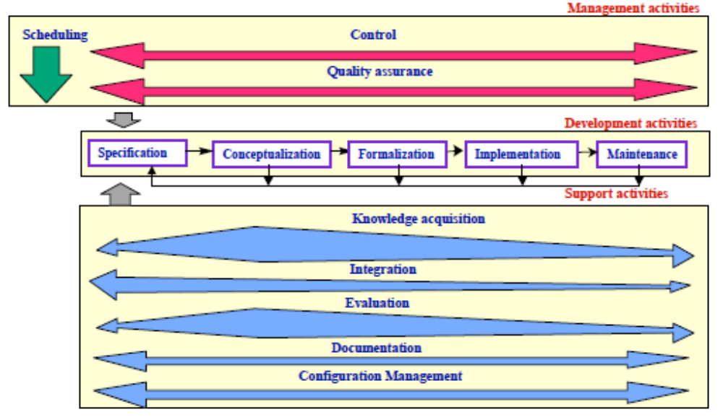
Ontology Life Cycle. Intra-dependencies

Slide 8
Ontology Evaluation
Ontology Verification refers to building the ontology correctly, that is, ensuring that its definitions implement correctly the ontology requirements and competency questions, or function correctly in the real world.
Ontology Validation refers to whether the ontology definitions really model the real world for which the ontology was created. The goal is to prove that the world model (if it exists and is known) is compliant with the world modeled formally.
Ontology Assessment is focused on judging the ontology content from the user’s point of view. Different types of users and applications require different means of assessing an ontology.

Slide 9
Consistency refers to whether it is possible to obtain contradictory conclusions from valid input definitions. A given definition is consistent if and only if the individual definition is consistent and no contradictory knowledge can be inferred from other definitions and axioms.
Completeness. Incompleteness is a fundamental problem in ontologies, even more when ontologies are available in such an open environment as the Semantic Web.
In fact, we cannot prove the completeness of an ontology nor the completeness of its definitions,
but we can prove the incompleteness of an individual definition, and therefore we can deduce the incompleteness of an ontology if at least one definition is missing in the established reference framework.

Slide 10
an ontology is complete if and only if
  All that is supposed to be in the ontology is explicitly stated in it, or can be inferred.
  Each definition is complete. This is determined by figuring out:
    (a) what knowledge the definition specifies and if it defines explicitly the world; and
    (b) for all the knowledge that is required but not explicit, it should be checked whether it can be inferred from other definitions and axioms. If it can, the definition is complete;
  otherwise, it is incomplete.

Slide 11
Conciseness. An ontology is concise if:
  it does not store any unnecessary or useless definitions,
  explicit redundancies between definitions of terms do not exist, and
  redundancies cannot be inferred from other definitions and axioms.

Slide 12
The ontologist should not postpone the evaluation until the taxonomy is finished; the control mechanisms should be performed during the construction of the taxonomy.
a set of possible errors that can be made by ontologists when modeling taxonomic knowledge in an ontology

Slide 13
Next Lecture 14

Slide 14
Ontology Evaluation
Ontology should be verified for
  Consistency
  Conciseness
Ontology should be validated for
  Completeness

Slide 15
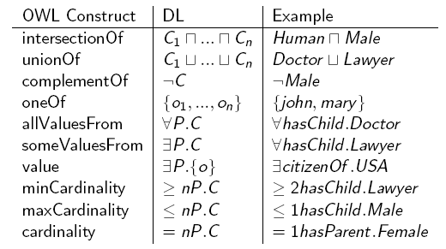

Slide 16
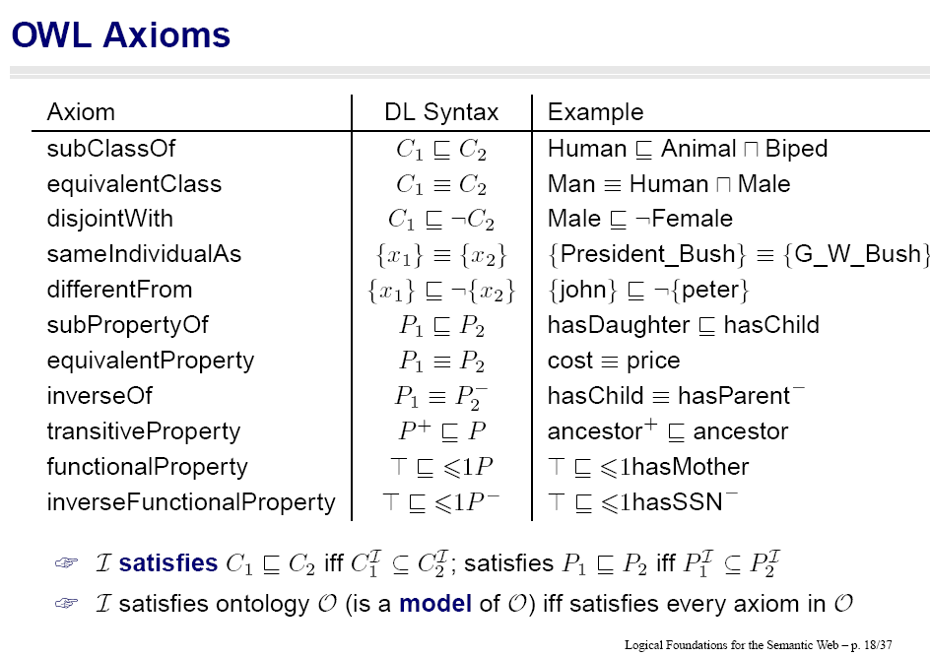
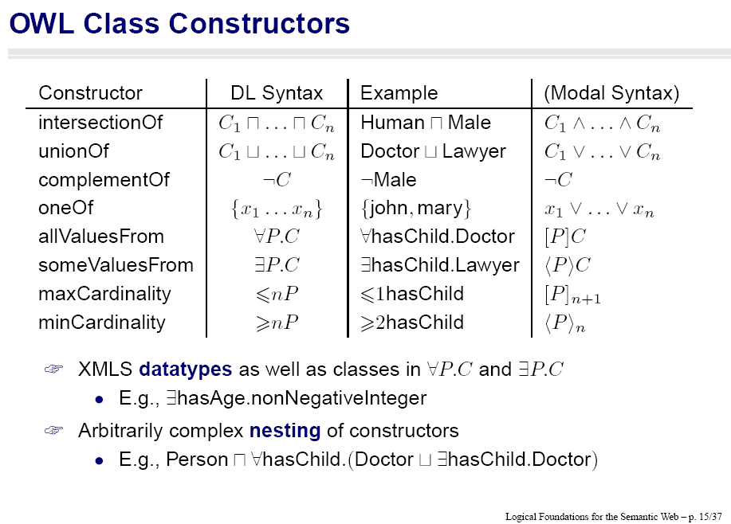

Slide 17
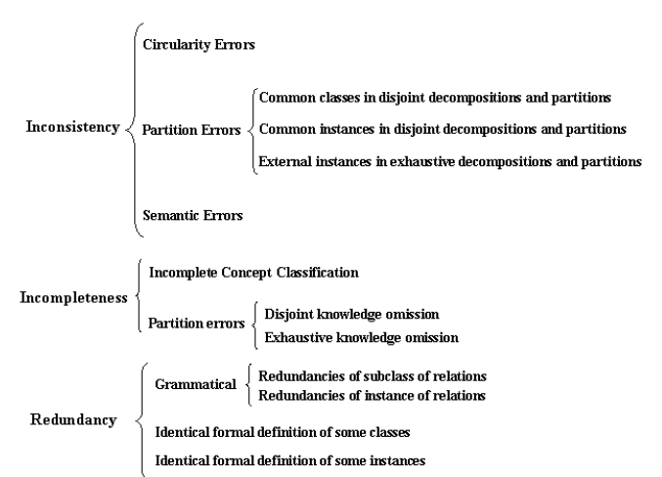

Slide 18
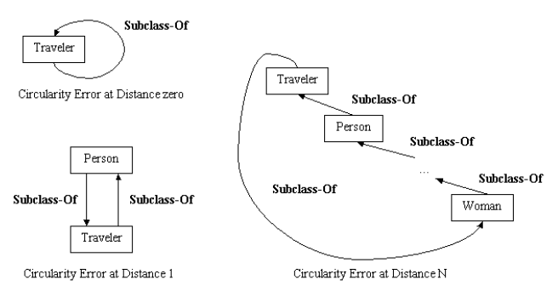
Inconsistency Errors
  Circularity errors. They occur when a class is defined as a specialization or generalization of itself.

Slide 19
    Circulatory Error in property hierarchy
    Common property in disjoint decomposition of properties

Slide 20
Semantic inconsistency errors: They usually occur because the ontologist makes an incorrect semantic classification, that is, (s)he classifies a concept as a subclass of a concept to which it does not really belong; for example, (s)he classifies the concept Airbus as a subclass of the concept Train. The same might happen when classifying instances.

Slide 21
Semantic inconsistency errors
More Generalized concept by subclass
Domain violation by subclass
Disjoint domain by subclass

Slide 22
Circulatory Error
  Circulatory Error in class hierarchy
  Circulatory Error in property hierarchy
Partition Errors
  Common class/instance in disjoint decomposition of classes
  Common property in disjoint decomposition of properties
  External instance in exhaustive decomposition and partition
Semantic Error
  More Generalized concept by subclass
  Domain violation by subclass
  Disjoint domain by subclass

Slide 24
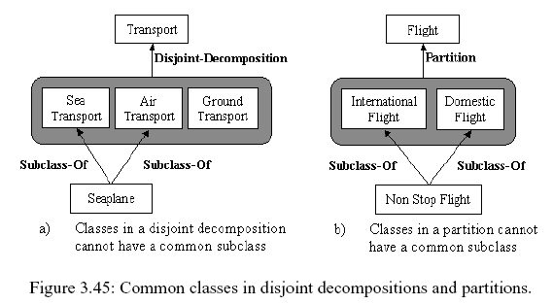
Incompleteness Errors
Partition errors. Concept classifications can be defined in a
  disjoint (disjoint decompositions),
  complete (exhaustive decompositions), and
  disjoint and complete manner
Common classes in disjoint decompositions and partitions.

Slide 25
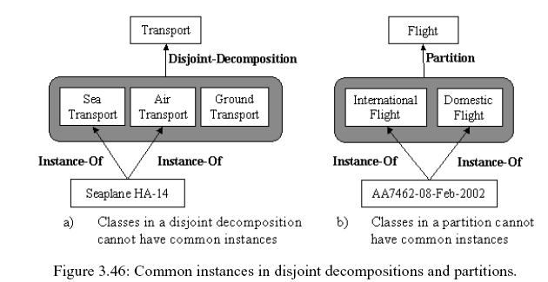
Common instances in disjoint decompositions and partitions. These errors happen when one or several instances belong to more than one class of a disjoint decomposition or partition.

Slide 26
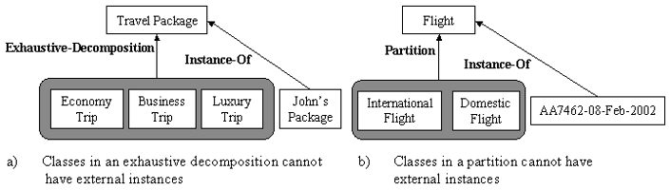
External instances in exhaustive decompositions and partitions.
These errors occur when we have defined an exhaustive decomposition or a partition of the base class (Class_A) into the set of classes class_p1,...,class_pn, and there are one or more instances of the class_A that do not belong to any class class_pi of the exhaustive decomposition or partition.

Slide 27
Incompleteness
  Partition Errors
    Disjoint Knowledge Omission among classes
    Disjoint Knowledge Omission among properties
    Exhaustive Knowledge Omission
    Sufficient Knowledge Omission
  Incomplete concept classification
  Functional and Inverse-Functional Tag Omission

Slide 29
Detecting incompleteness on taxonomies. Errors appear when the superclasses of a given class are imprecise or over-specified, and when information about subclasses that belong to disjoint decompositions, exhaustive decompositions, and partitions is missing.
Incomplete Concept Classification. Generally, an error of this type is made whenever concepts are classified without accounting for them all, that is, concepts existing in the domain are overlooked. On the traveling domain, an error of this type occurs if we classify locations only taking into account beach locations and mountain locations, and we do not consider cultural locations, skiing locations, etc.

Slide 30
Partition Errors. They could happen when the definition of disjoint and exhaustive knowledge between classes is omitted.
  Disjoint knowledge omission. The ontologist identifies the set of subclasses of a given class, but omits to model, in the taxonomy, that the subclasses are disjoint. An example would be to define the classes South American Location and North American Location as subclasses of American Location, without specifying that they form a disjoint decomposition of the class American Location.
  Exhaustive knowledge omission. The ontologist defines a decomposition of a class, omitting the completeness constraint between the subclasses and the base class. An example would be to define South American Location and North American Location as a disjoint decomposition of an American Location without specifying that they form an exhaustive decomposition.

Slide 32
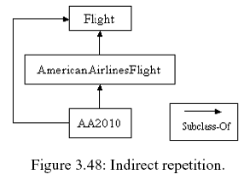
Redundancy detection. It occurs in taxonomies when there is more than one explicit definition of any of the hierarchical relations, or when we have two classes or instances with the same formal definition.
  Redundancies of Subclass-Of relations occur between classes that have more than one Subclass-Of relation.

Slide 33
Redundancies of Instance-Of relations.
Identical formal definition of classes. Different classes have the same formal definition, although they have different names.
Identical formal definition of instances. Different instances have the same definition, although they have different names.

Slide 34
Redundancy
  Redundancy of subclass/instance of relations
  Redundancy of subproperty of relations
  Redundancy of disjoint of relations among classes
  Redundancy of disjoint of relations among properties
  Grammatical
    Identical formal definition of classes/instances
    Identical formal definition of properties

Slide 36
Inconsistency
  Circulatory Error
    Circulatory Error in class hierarchy
    Circulatory Error in property hierarchy
  Partition Errors
    Common class/instance in disjoint decomposition of classes
    Common property in disjoint decomposition of properties
    External instance in exhaustive decomposition and partition
  Semantic Error
    More Generalized concept by subclass
    Domain violation by subclass
    Disjoint domain by subclass
Incompleteness
  Partition Errors
    Disjoint Knowledge Omission among classes
    Disjoint Knowledge Omission among properties
    Exhaustive Knowledge Omission
    Sufficient Knowledge Omission
  Incomplete concept classification
  Functional and Inverse-Functional Tag Omission
Redundancy
  Redundancy of subclass/instance of relations
  Redundancy of subproperty of relations
  Redundancy of disjoint of relations among classes
  Redundancy of disjoint of relations among properties
  Grammatical
    Identical formal definition of classes/instances
    Identical formal definition of properties
Notes:
Owl ontologies provide constructs to build property hierarchies, i.e. datatype property heirarchy and object property hierarchy.
Thus circulatory errors may occurs in properties by specifying a property as subproperty or superproperty of itself.
To provide better semantic of data, owl also provides disjoint axioms between properties.
Thus a common property in disjoint decomposition of properties occur.
The semantic errors which occur due to wrong classification of concepts are categorized into three types of errors.
The error more generalized concept by subclass occurs as ontologist has made subclass concept which contains all the feature of its super concept.
The other type is domain violation by subclass error that happens when ontologist has made subclass concept which contains some of the features and violates some of the feature of its super concept.
The another type of semantic error occurs when a subclass posses a disjoint domain as compared to its super concept.
These types of errors occurs as ontologies has not specialized the concept going down in the hierarchy.
In the incompleteness errors disjoint knowledge omission among properties may create serious consequences.
First we have analyzed that Disjoint knowledge omission among classes can cause catastrophic consequences. We have developed access policy ontology
In which disjoint knowledge omission between customer and administrator causes customer to access administrator rights. Then we have provided the disjoint knowledge axiom between customer and administrator but again customer can have access to administrator rights,
This was just becoz of disjoint knowledge omission among properties hascustomerAccess and hasAdministratorAccess.
Sufficient knowledge omission is another type of incompleteness error. It lacks reasoning power of ontologies. According to dl rules, there are
Two types of crateria by which a concept is defined. The necessary crateria defines the concept by subclass of relation in the hierarchy, and sufficient knowledge elaborates the concepts by property restriction, axioms in terms of other concepts. Sometimes concepts are created in the ontologies but
Their sufficient knowledge was not provided. Due to Lack of sufficient knowledge, machine does not interpret and reason the concept especially they does not Distinguish the sibling concepts.
Functional and inversefunctional tags have much important in ontologies. Functional tag restricts property to hold one value and inverse functional uniquely identifies the concept. This type of omission also creates inconsistencies if properties does not have tags where they require. The main cause of such omission is that owl by default allow a single property to hold multiple values. Due to ignorance to such fact, properties by default holds multiple values creating inconsistent values.
In redundancy errors, there can be a redundancy of subproperty of relations. This type of error occurs when a property is specified as subproperty of a its own ancestor property
The another type of redundancy occurs when two indirect disjoint concepts are specified as disjoint concepts in the ontologies.
When two concepts (A and B) are disjoint then the concept A is indirectly disjoint with all the children of B and the children of A are indirectly disjoint with
The concept B and all of its child concepts. Providing disjoint axiom again among them creates redundancy of this type. Such a redundancy can happen in class and property hierarchies.
The another type of redundancy happens when ontologies provide identical formal definitions of properties by creating properties that have
Syntatically or semantically same names with having same domain and range concepts.

